Slide 1
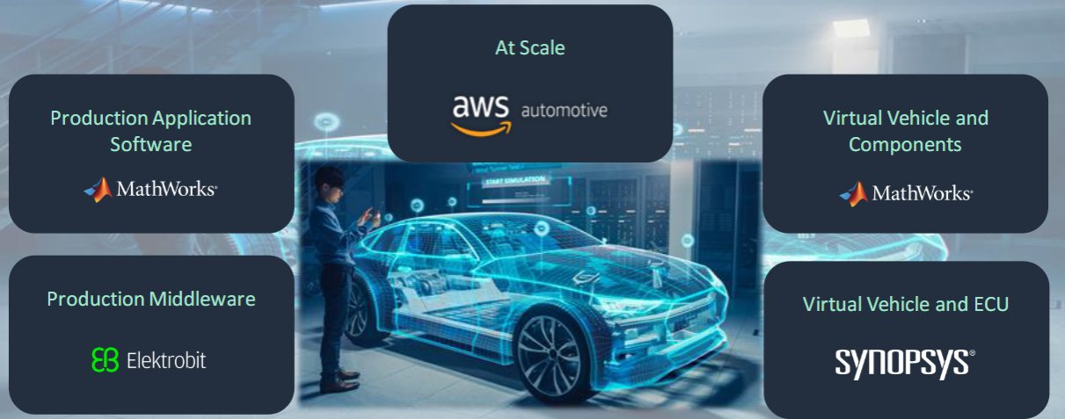
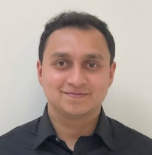
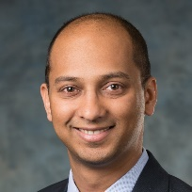
Developing the Software-Defined Vehicle with MBD Scaling software development demonstrating automated testing, and cloud resources
Sameer K Muckatira,
Application Engineering
Nitish Rao
Automotive Industry Marketing
May 13th, 2024

Slide 2
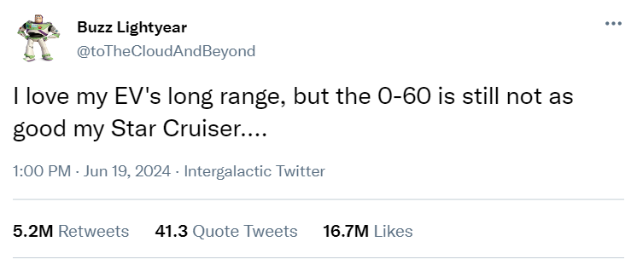
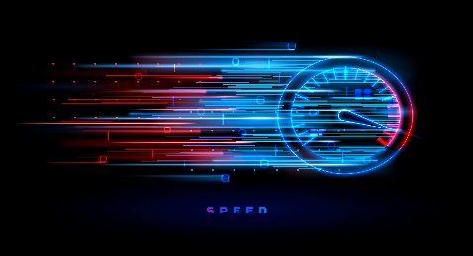




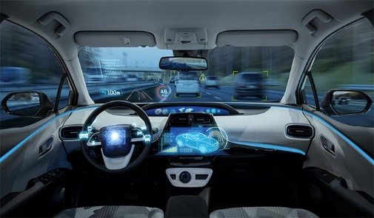
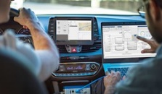
Motivation
Can we release new software without any Vehicle/HiL time?
“Sport+” Mode
▲ Reduce 0-60mph time
↔ Minimum Range Change
Infotainment System (IVI)
QM
Vehicle Control Unit (HPC)
ASIL-B
Battery Management
(Embedded Edge)
ASIL-D

Slide 3



EV Sport+ Mode
Stakeholder needs - How will it function?
“Sport+” Mode
▲ Reduce 0-60mph time
↔ Minimum Range Change
Can we build the VCU and BMS? How do we test the application software?
Infotainment System (IVI)
QM
Vehicle Control Unit (HPC)
ASIL-B
Battery Management
(Embedded Edge)
ASIL-D
Driver Requests for Sport+ Mode
Confirm no faults, Confirm Battery > 25%
Increase available power

Slide 4
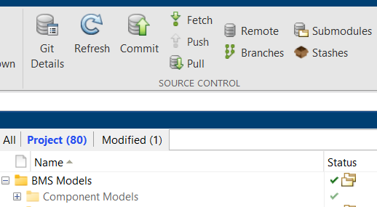








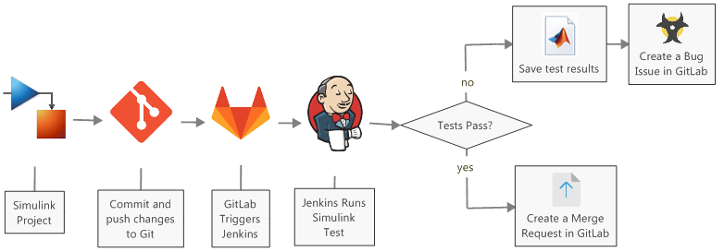



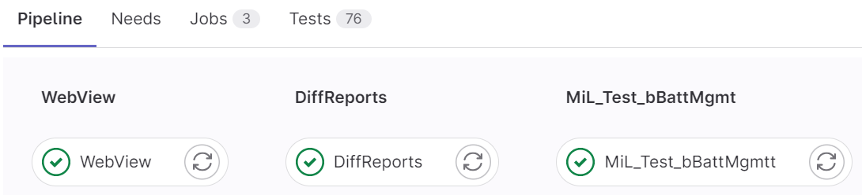
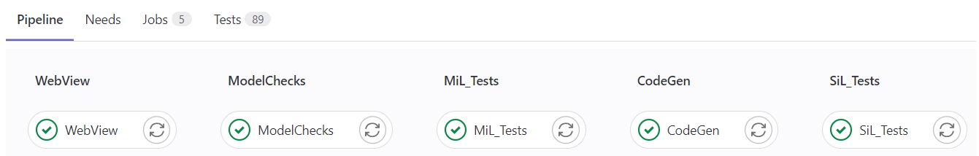
SDV Development in Action
Automated testing and codegen via Continuous Integration
Challenge:
Enable multiple engineers to simultaneously develop features in parallel, but can share and sync with the other colleagues
Test application code while still in development, thereby creating a “fix-as-you-go” workflow
Automate large scale testing and code generation when development branches are merged to main/release branch
Solution:
bBattMgmt
main
bVCU
Commit changed models/tests to git using Projects
Virtualize
Componentize models and place them under source control
Test at model level, application software level, and conduct MISRA C checks
Setup non-interactive MATLAB on runner computer(s); and perform automated tests, codeGen, and report authoring tasks
> matlab -batch
Automated pipelines can be configured to run in a variety of environments, to meet your scaling needs
Scale
https://insidelabs-git.mathworks.com/AE-Content/demos/ev_dualmotor_ctrl

Slide 5
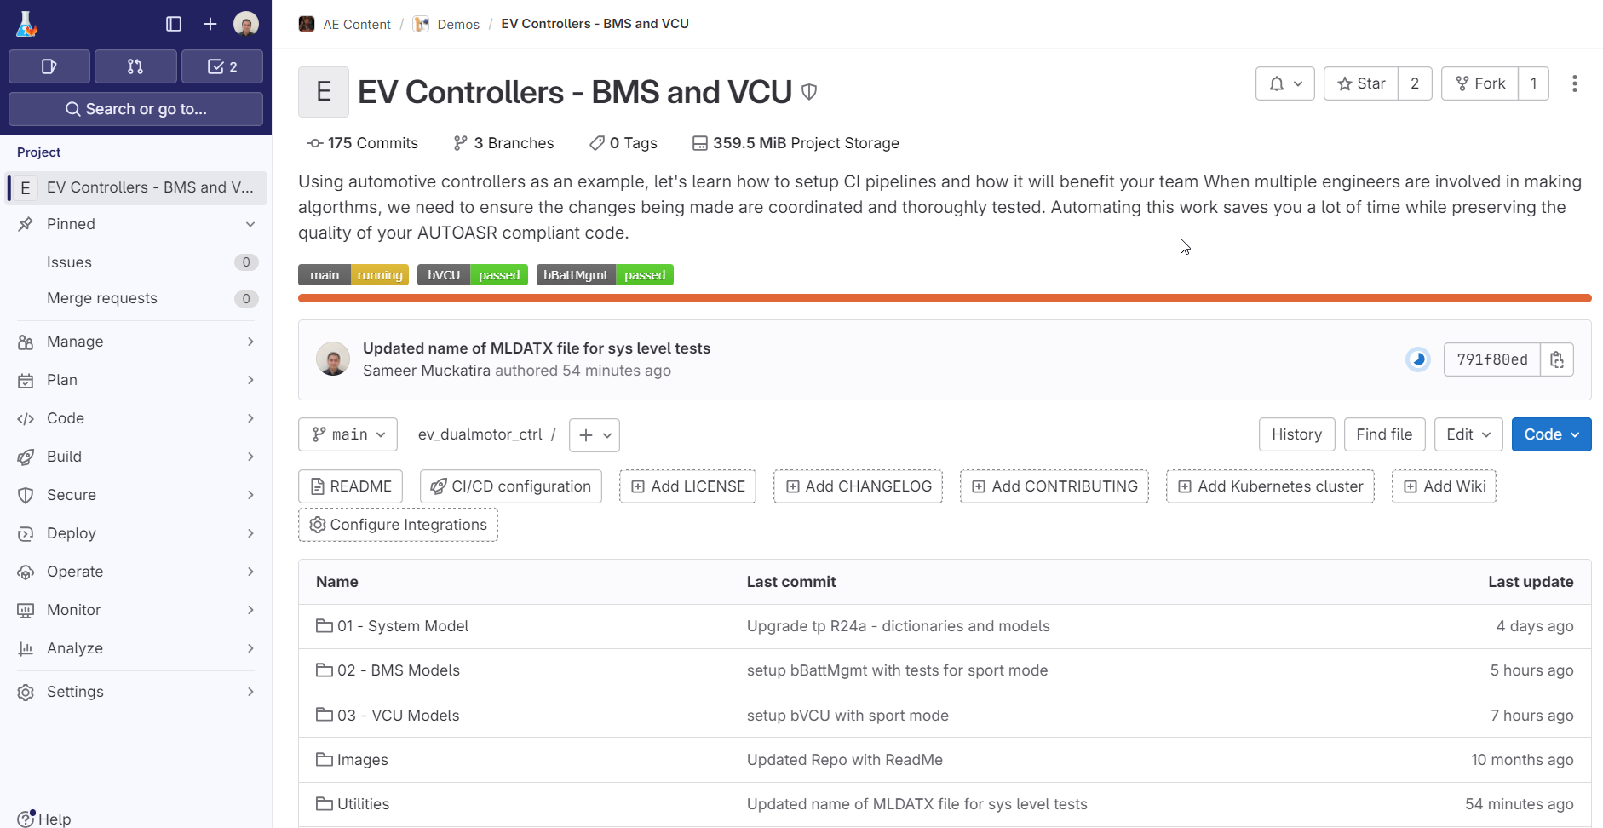
Clone the repository
https://insidelabs-git.mathworks.com/AE-Content/demos/ev_dualmotor_ctrl

Slide 6
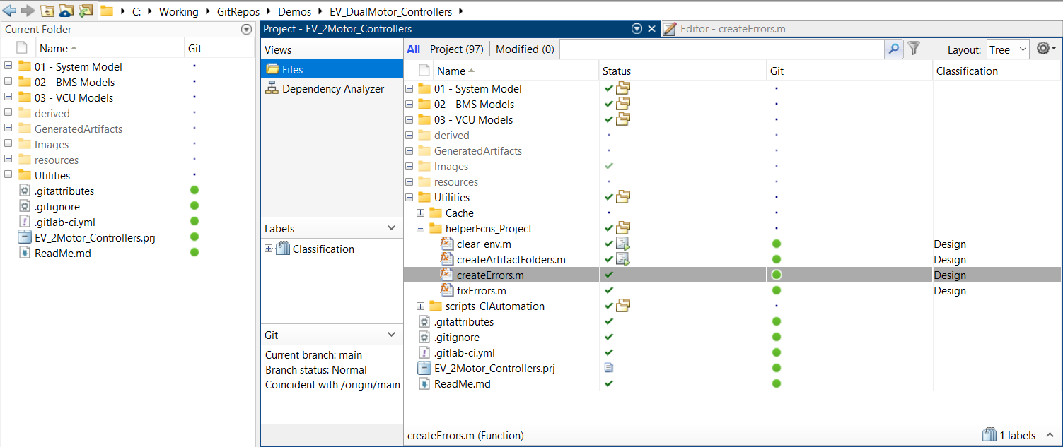
Open the Project Run “createErrors.m”

Slide 7
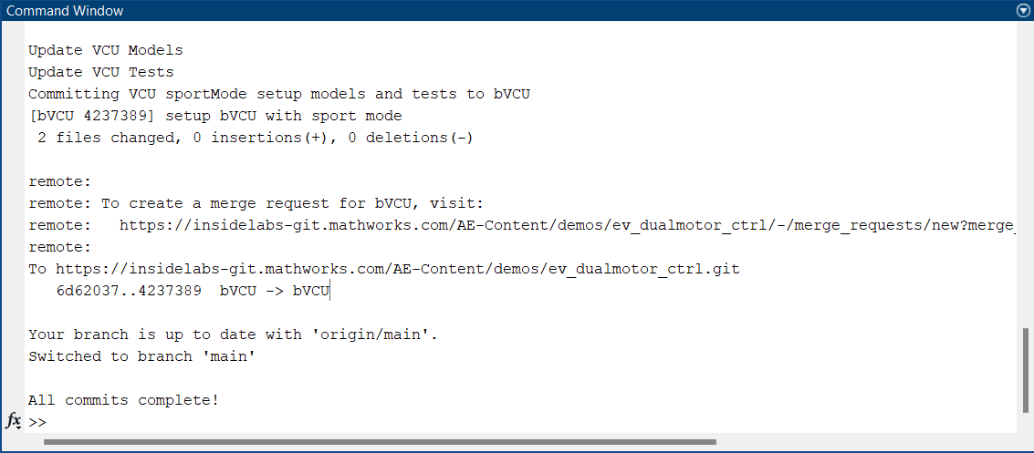
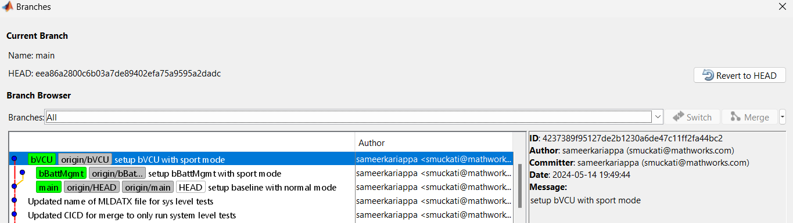
All 3 branches are updated

Slide 8
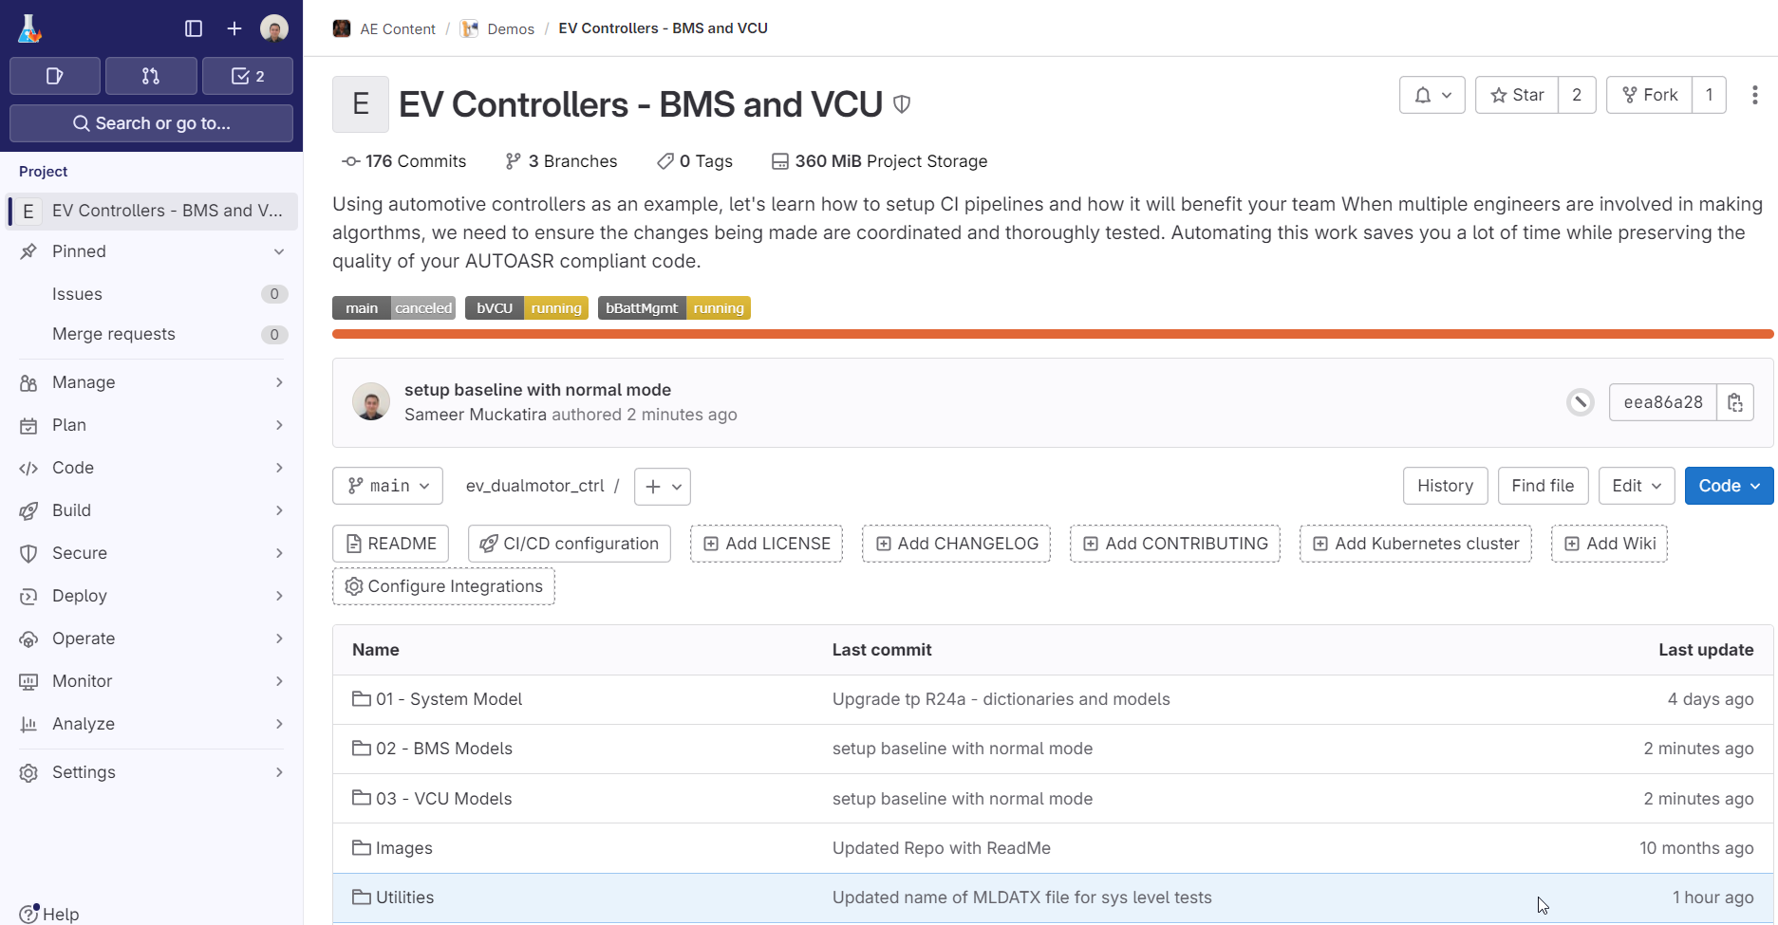
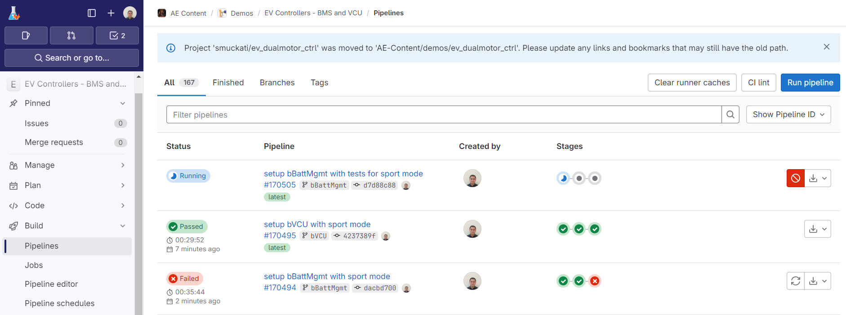
All 3 branches are updated Automated pipeline on development branches get run
Note: Wait for these pipelines to complete before proceeding!

Slide 9
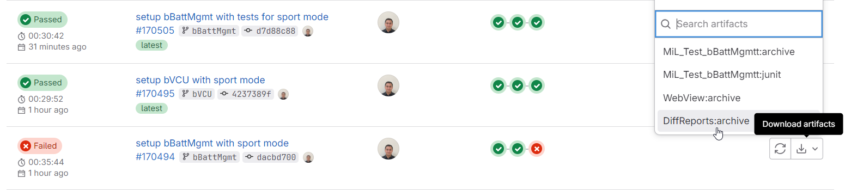
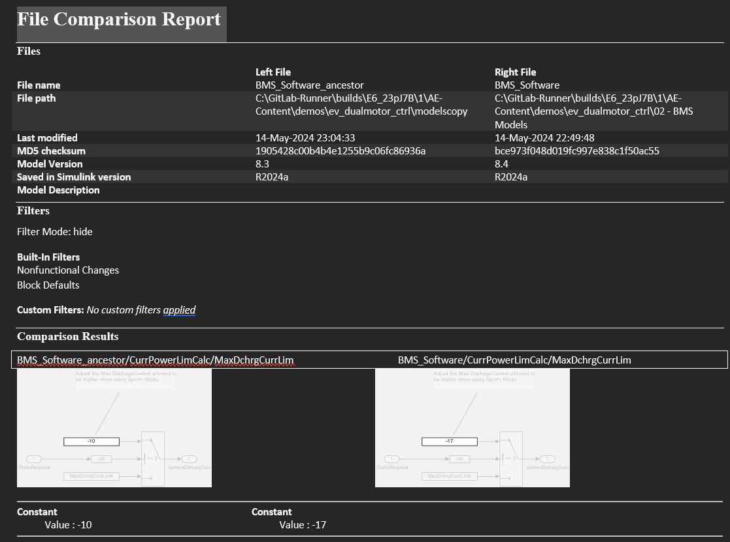
For design reviews: Automated diff reports for SLX Also create reports for SLDD/SLMX/SLREQX

Slide 10
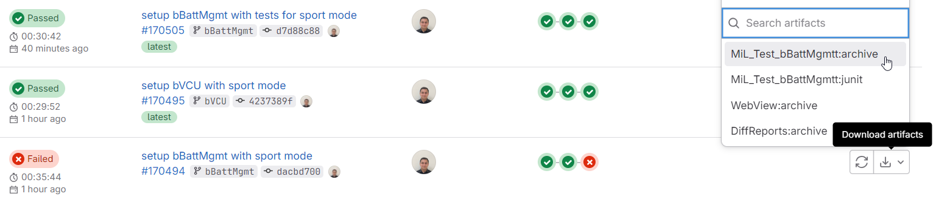
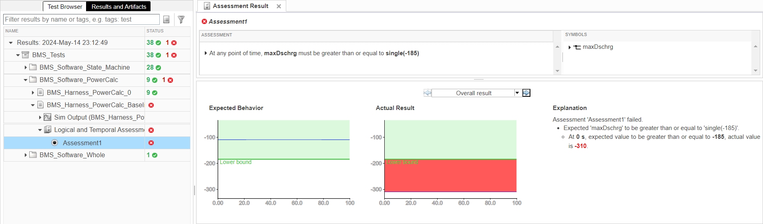
Catch Errors: Review automated test results

Slide 11
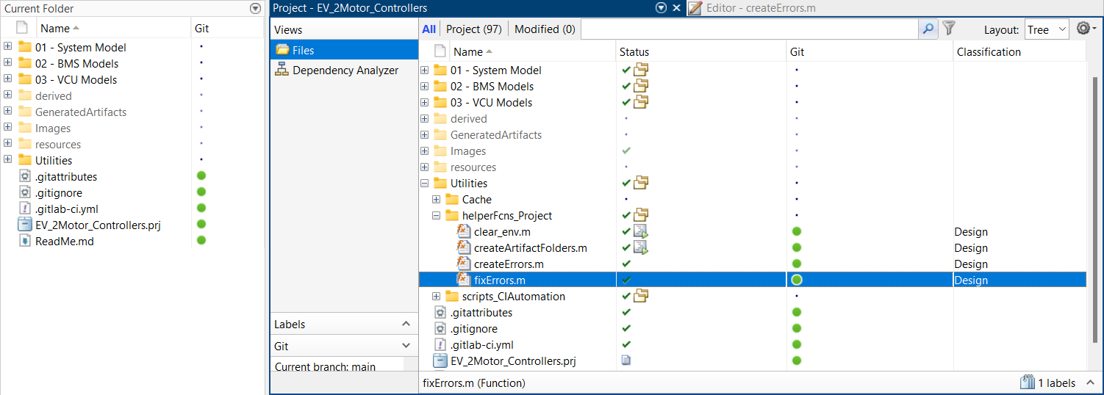
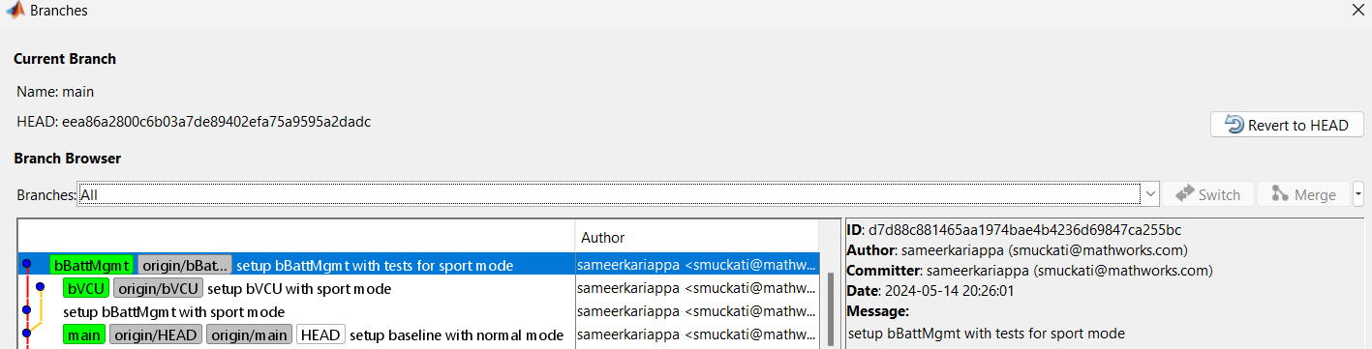
Run “fixErrors.m” bBattMgmt updated to pass the failed test

Slide 12
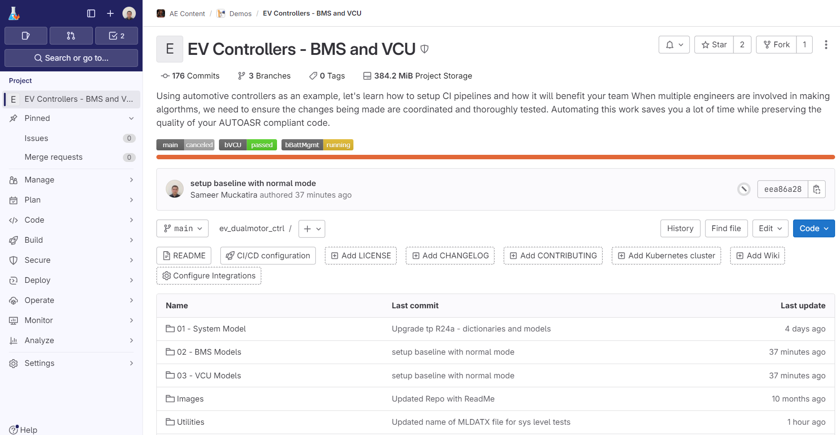
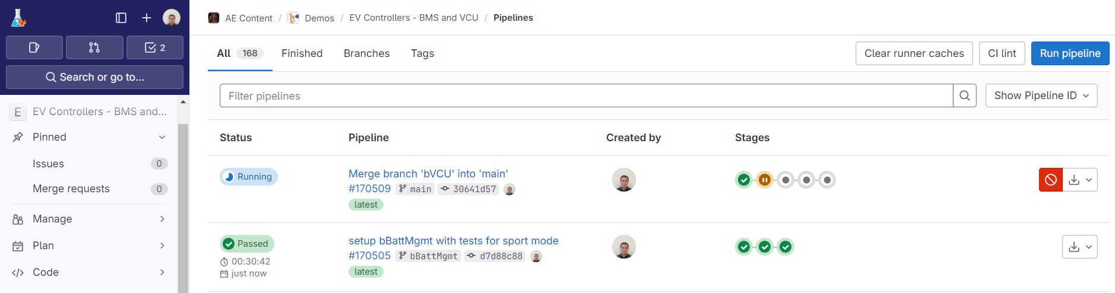
bBattMgmt updated Automated pipeline on branch is run
Note: Wait for this pipeline to complete before proceeding!

Slide 13
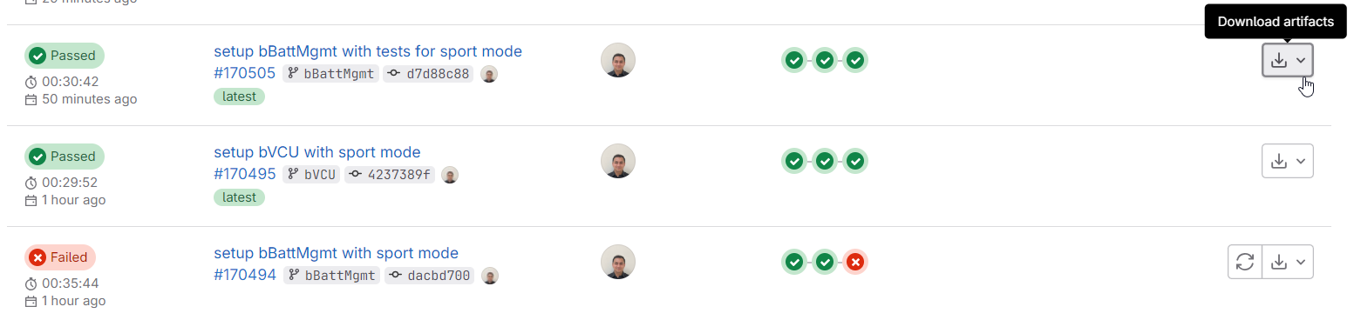
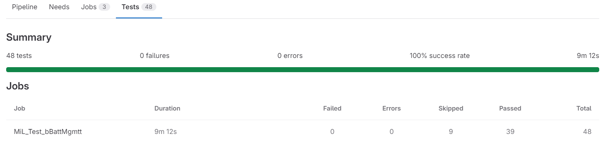
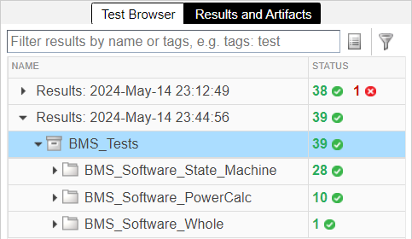
Fixed Errors: Review automated test results
https://insidelabs-git.mathworks.com/AE-Content/demos/ev_dualmotor_ctrl/-/pipelines/170505/test_report

Slide 14
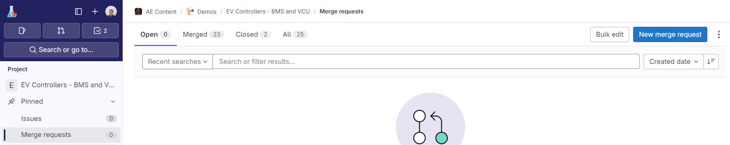
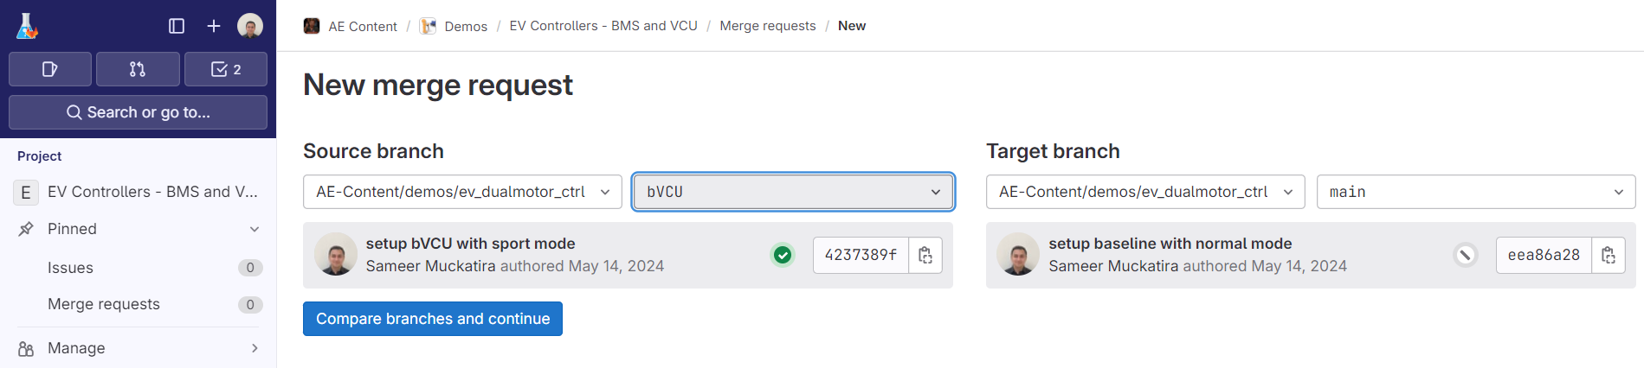
Merge the bVCU branch to the main

Slide 15
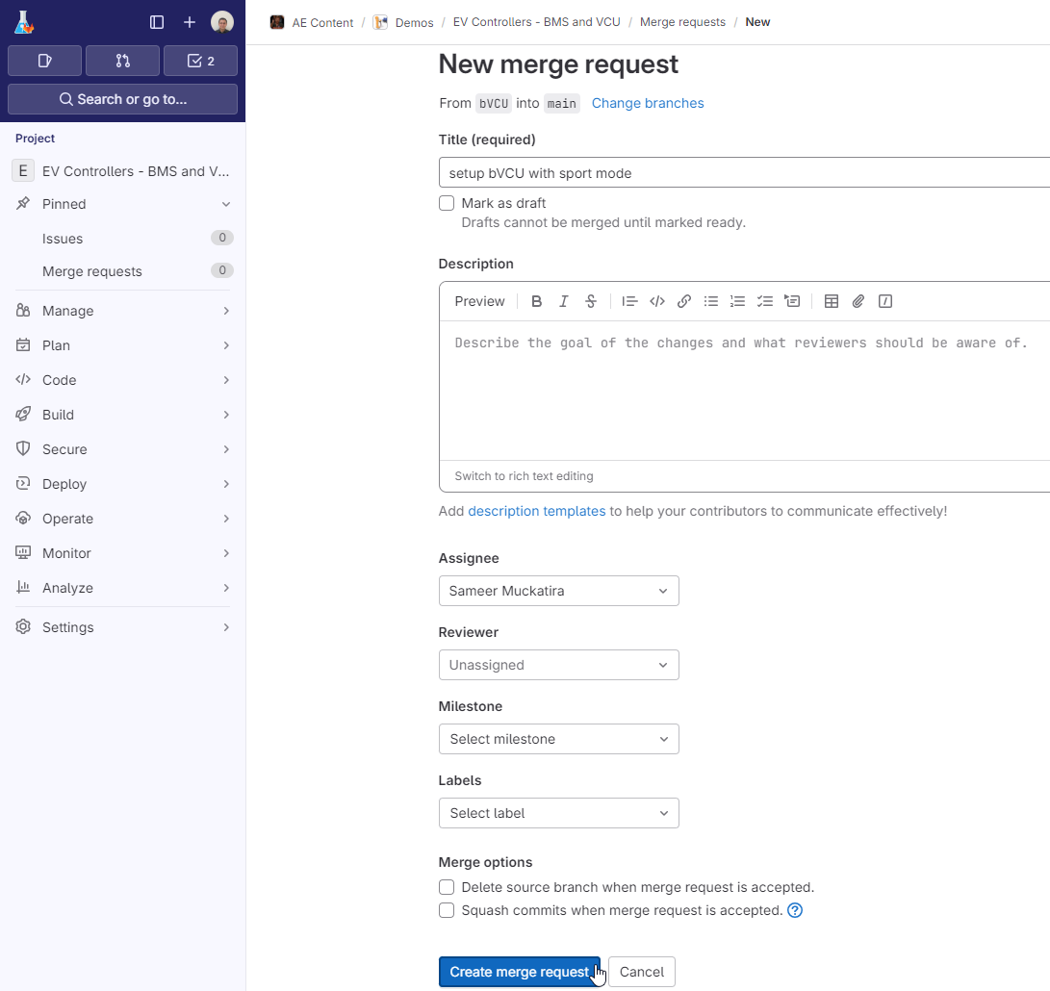
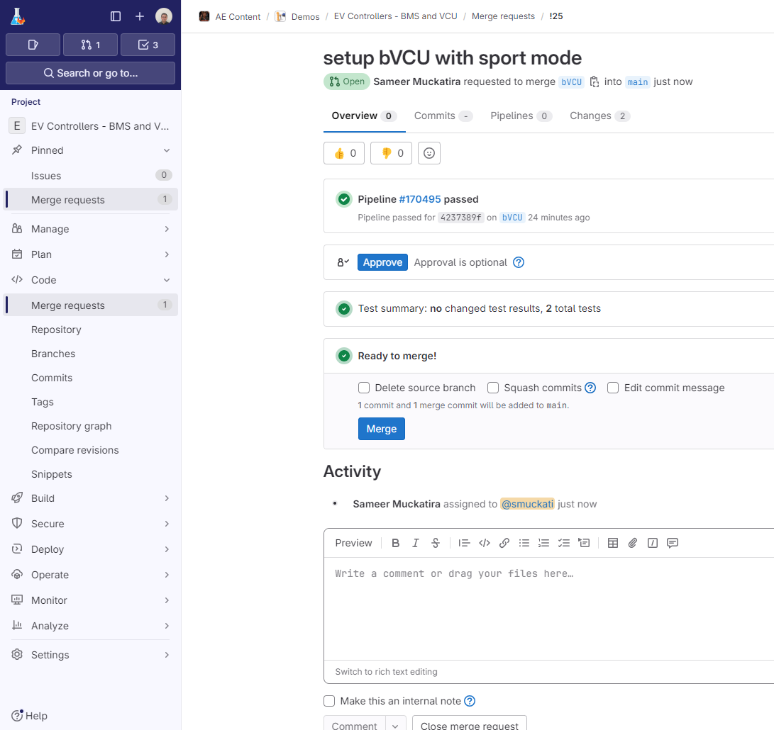
Merge the VCU branch to the main
Approve the request
Assign to yourself
Merge the branch
Uncheck this box

Slide 16
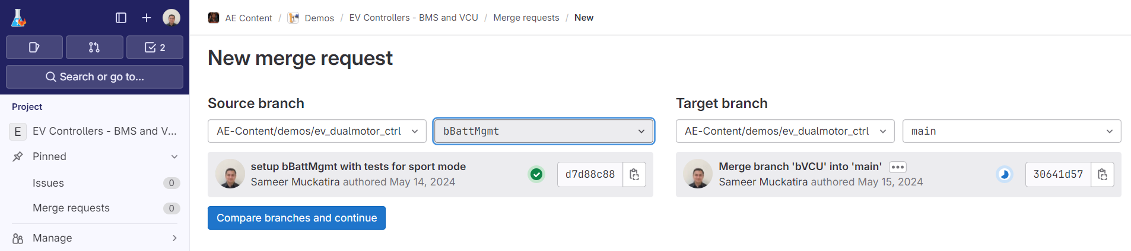
Merge the bBattMgmt branch to the main

Slide 17
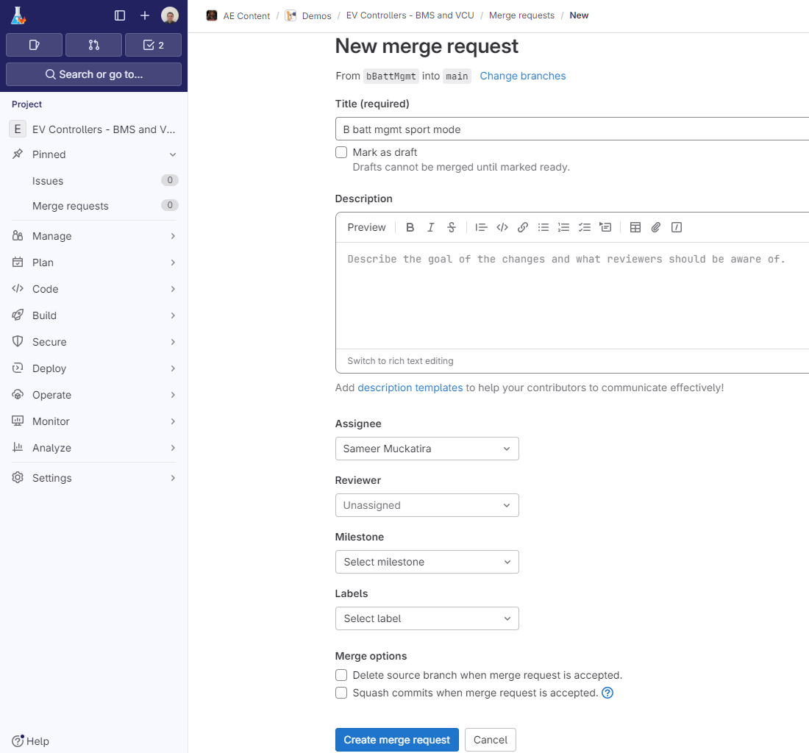
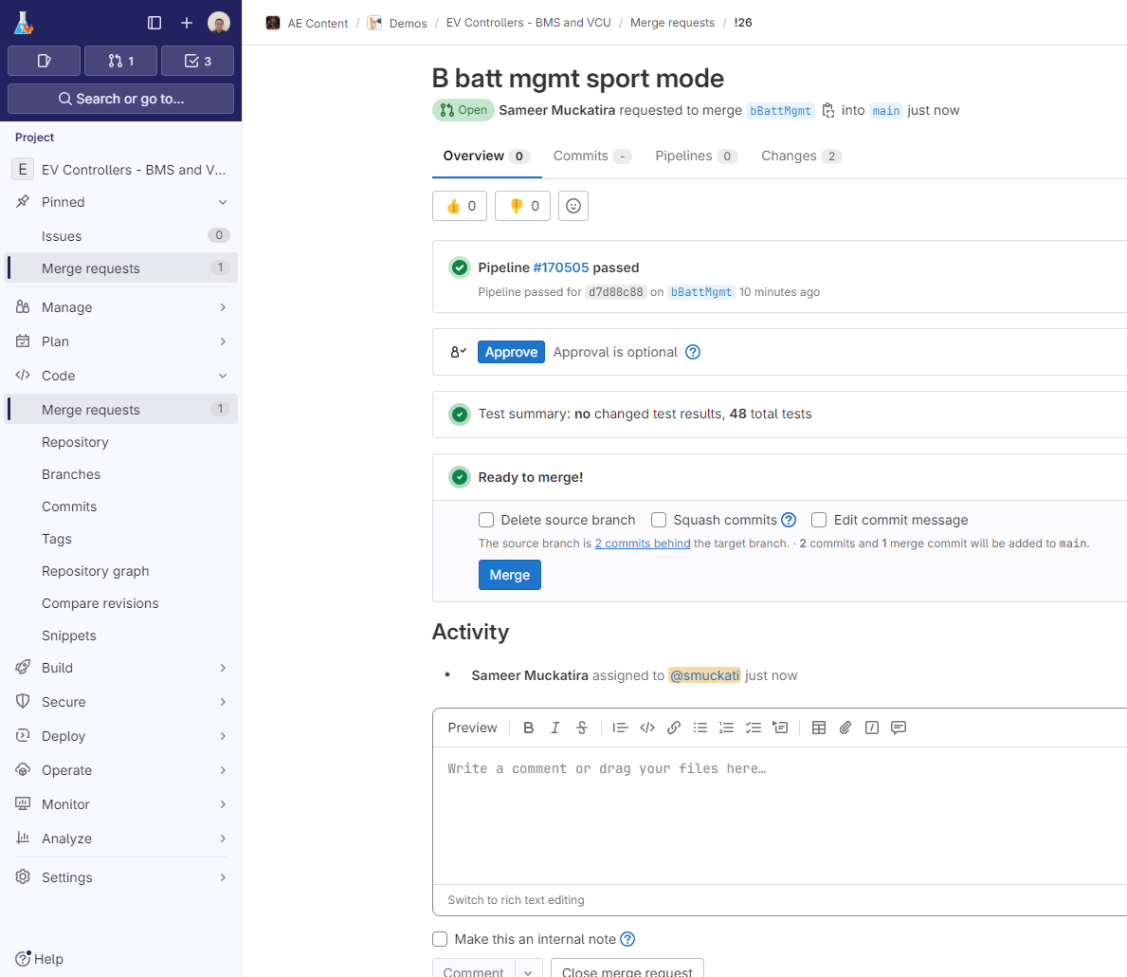
Merge the bBattMgmt branch to the main
Approve the request
Assign to yourself
Merge the branch
Uncheck this box

Slide 18
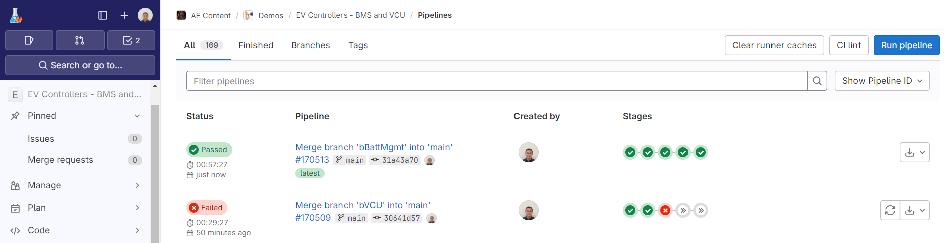
Merged main successfully passes all tests!
System tests pass once Batt Management updates are merged!
System tests initially fails since Batt Management updates are not yet in
https://insidelabs-git.mathworks.com/AE-Content/demos/ev_dualmotor_ctrl/-/pipelines

